Slide 1
CHAPTER 2
POLAR COORDINATES

Slide 2
CONTENTS
2.1. Polar Coordinate System
2.2. Curves in Polar Coordinates
2.3 Areas & Lengths in Polar Coordinates
2.4. Conic Sections in Polar Coordinates

Slide 3
2.1. Polar Coordinate System
To describe the polar coordinate system we choose a point 0 in the plane called the pole, and a (horizontal) ray starting from 0 called the polar axis.
If P is any point in the plane, let r be the distance from 0 to P and let θ be the oriented angle between the polar axis and the line 0P. Then r, θ are polar coordinates of P
P(r,θ)
We agree that (0, θ) represents the pole for any value of θ
r
θ
0
polar axis

Slide 4
We extend the meaning of polar coordinates (r, θ ) to the case in which r is negative.
The two points (r, θ ) and (- r, θ ) are symmetric with respect to 0.
Note that (- r, θ ) and ( r, θ+π ) represent the same point
(r,θ )
r
θ
0
polar axis
(-r,θ )

Slide 5
Example. Plot the points whose polar coordinates are given: (a) (1, 5π/4) (b) (2, 3π) (c) (2, -2π/3) (d) (-3, 3π/4)
Solution. We have
3π
5π/4
(2, 3π)
0
0
(1, 5π/4)
3π/4
0
0
-2π/3
(2,-2π/3)
(-3, 3π/4)

Slide 6
Note.
In the Cartesian coordinate system every point has only one representation, but in polar coordinate system each point has many representations.
For instance, the point (1, 5π/4) could be written as (1, -3π/4) or (1, 13π/4) or (-1, π/4)
In fact the point (r, θ) is also represented by
(r, θ+2nπ), and (-r, θ+(2n+1)π)

Slide 7
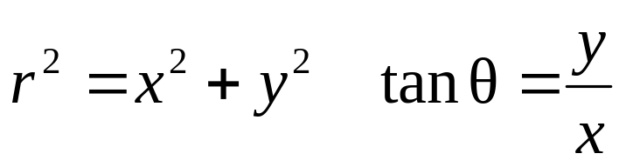
The connection between polar and Cartesian coordinates is given by
x = r cos θ y = r sin θ
To find Cartesian coordinates when polar coordinates are given we use
P(r,θ)=P(x,y)
r
y
θ
x

Slide 8
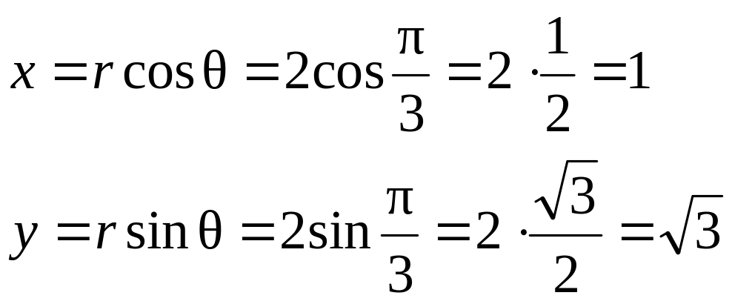
Example. Convert the point (2, π/3) from polar to Cartesian coordinates
Solution. Since r = 2, θ = π/3 we have

Slide 9
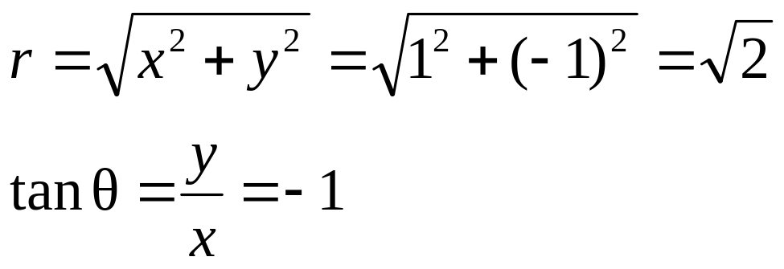
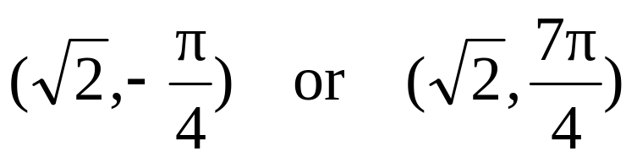
Example. Represent the point with Cartesian coordinates (1, -1) in terms of polar coordinates
Solution. If r is positive then
Since (1, -1) lies in the fourth quadrant, we can choose θ = -π/4 or θ = 7π/4. Thus some possible answers are

Slide 10
2.2. The Graph of a Polar Equation
Example. What curve is represented by the polar equation r = 2?
Solution. The curve consists of points (r, θ) with r=2: this is the circle with center 0 and radius 2. In general the equation r=a represents a circle with radius a
r = 2
θ
0

Slide 11
Example. Sketch the polar curve θ = 1
Solution. This curve consists of all point (r, θ) such that the polar angle θ is 1 radian:
(3, 1)
This is the straight line passing through 0 and making an angle 1 radian with respect to the polar axis.
(2, 1)
θ = 1
(1, 1)
0
1
(-1, 1)
(-2, 1)

Slide 12










Example. (a) Sketch the polar curve r= 2cosθ
(b) Find a Cartesian equation for this curve
Solution. We draw a table of values for r as a function of θ and plot the corresponding points
θ | r=2cos θ | θ | r = 2cos θ
0 | 2 | 2π/3 | -1
π/6 |  | 3π/4 | -
π/4 |  | 5π/6 | -
π/3 | 1 | π | -2
π/2 | 0
Using these points we can sketch the curve which seems to be a circle

Slide 13
Solution. (b) Since x = r cosθ we have
2x = 2r cosθ = r² = x² + y² or
x² + y² – 2x = 0
Completing the square we obtain
(x – 1)² + y² = 1
Which is an equation of a circle with center (1,0) and radius 1.
P
r
θ
(1,0)
Q
0

Slide 14
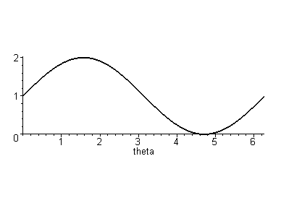
Example. Sketch the curve r = 1 + sin θ
Solution. To plot the points, we first sketch the graph of r = 1 + sin θ in Cartesian coordinates.
From this graph we have the table of variation for r
θ
0
π/2
π
3π/2
2π
r
1
2
1
0
1
Using this table we can plot the graph of the given curve

Slide 15
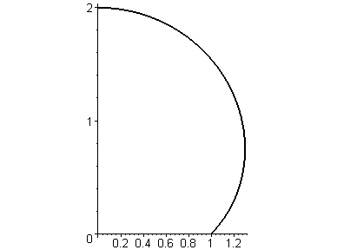
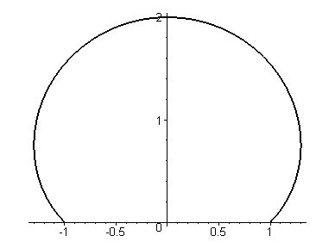
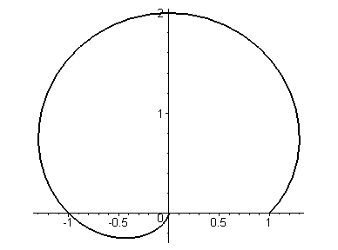
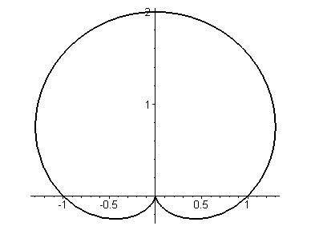
θ
0
π/2
π
3π/2
2π
r
1
2
1
0
1

Slide 16
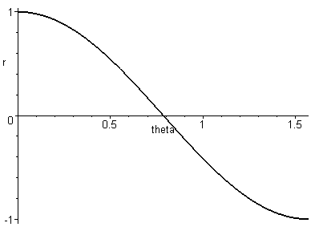
Example. Sketch the curve r = cos 2θ
Solution. We have cos 2(-θ) = cos 2θ , and cos 2(π – θ) = cos 2θ so that the graph is symmetric about the x-axis and the y-axis.
Therefore we need to plot the graph only for 0 ≤ θ ≤ π/2.
We first sketch the graph of r = cos 2θ in Cartesian coordinates and draw the table of variation for r
θ | 0 | π/4 | π/2
r | 1 | 0 | -1

Slide 17
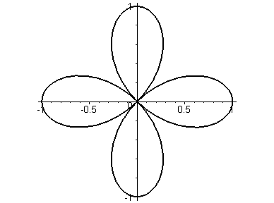
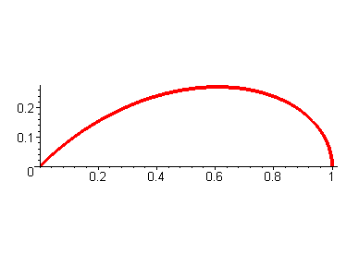
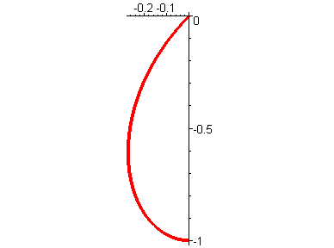
θ
0
π/4
π/ 2
r
When θ increases from 0 to π/4, r decreases from 1 to 0: we get the upper half of the curve in the first quadrant
When θ increases from π/4 to π/2, r decreases from 0 to -1: we get the lower half of the curve in the third quadrant
θ = 3π/4
θ = π/2
θ = π/4
The graph is completed by the symmetries about the two axis. The curve is a four-leave rose
θ = π
θ = 0

Slide 18
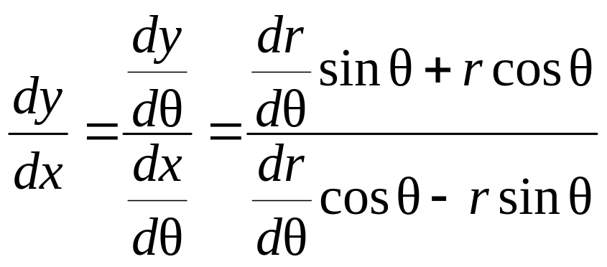
Tangents to Polar Curves
To find the tangent line to a polar curve r=f(θ), we regard θ as a parameter and write the parametric equations of the curve
x = r cosθ = f(θ) cosθ y = r sinθ = f(θ) sinθ
Therefore

Slide 19
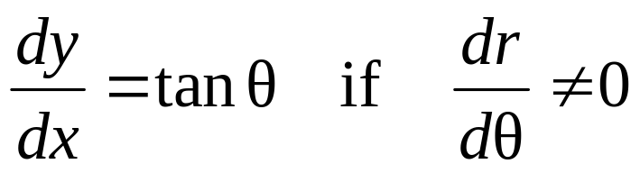
To find the horizontal tangents we solve the equation
dy/dθ = 0, dx/dθ ≠ 0
Similarly to find the vertical tangents we solve the equation
dx/dθ = 0, dy/dθ ≠ 0
Note that the tangent lines at the pole correspond to r = 0. Hence

Slide 20
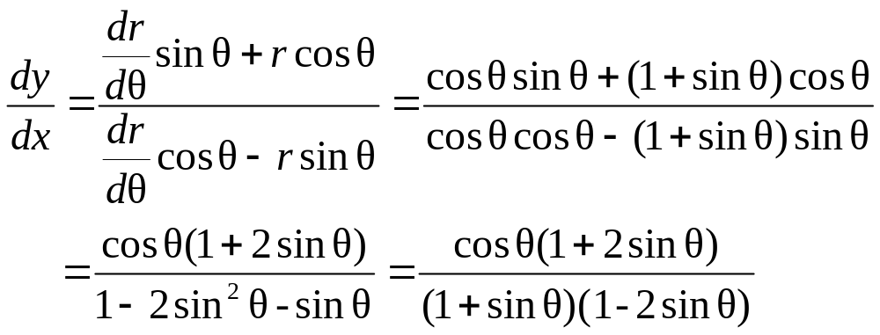
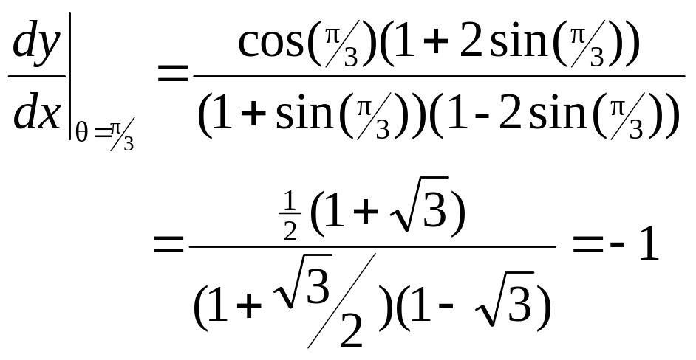
Example. (a) Find the slope of the tangent line of the cardioid r = 1 +sinθ at θ = π/3
Solution.
With θ = π/3 we have

Slide 21
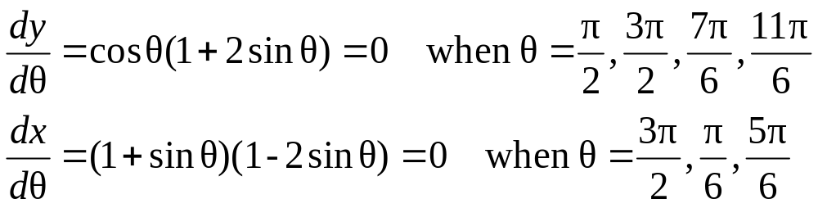
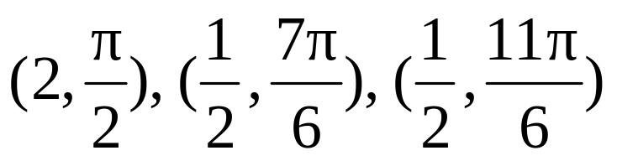
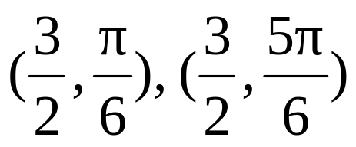
(b) Find the points of the cardioid where the tangent line is horizontal or vertical
Solution. Observe that
Therefore the tangent line is horizontal at the points
And the tangent line is vertical at the points

Slide 22
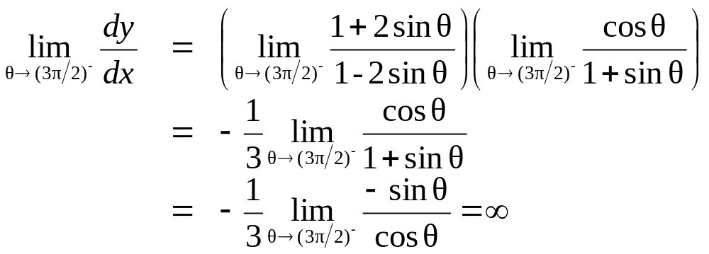
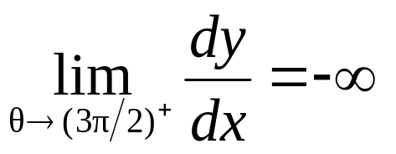
When θ=3π/2, both dy/dθ and dx/dθ are 0 so we use l'Hospital's Rule to find the limit of dy/dx
By symmetry
Hence the tangent line at the pole is vertical

Slide 23
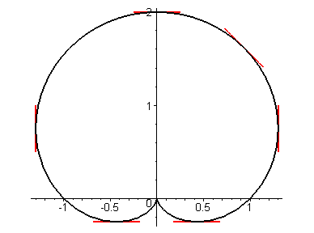

Slide 24
Graphing Polar Curves with Graphing Devices
MAPLE's command plot with the option coords=polar allows us to graph a polar equation
r = f(θ)
However if we want to graph together several curves given by both polar equations and Cartesian equations, we have to convert them to parametric curves and use plot command to plot family of parametric curves
or using command plots[display]

Slide 25
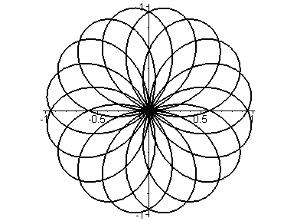
Example. We can graph the curve r = sin(8θ/5) with the following MAPLE's command
>plot(sin(8*theta/5),theta=0..10*Pi,color=black, coords=polar);

